Slide 1

MSP | Email | VoIP | Network | Wi-Fi | Access Control | Camera | Alarm
Interested? (813) 444–4355

Slide 2



From Cyber To Physical
MSP | Email | VoIP | Network | Wi-Fi | Access Control | Camera | Alarm
Interested? (813) 444–4355

Slide 3
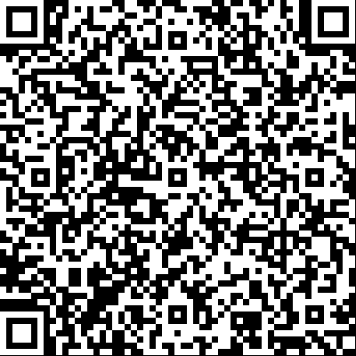
Scan To Download PowerPoint
MSP | Email | VoIP | Network | Wi-Fi | Access Control | Camera | Alarm
Interested? (813) 444–4355

Slide 4
Licenses & Certifications
Florida Licenses / Certifications
ES12001800 (Cert Specialty)
EF20001261 (Cert Alarm I)
Burglar Alarm System Agent (BASA)
Fire Alarm System Agent (FASA)
Federal Licenses
FCC 835667
STIR/SHAKEN 7225408881
CompTIA Certifications
CompTIA A+
CompTIA Network+
CompTIA Security+
Product / Manufacturer Certifications
Google
Microsoft
Eagle Eye Networks Advanced
Eagle Eye Networks VMS
Eagle Eye Networks LPR
Brivo Door Access Control Advanced
Hanwha Surveillance
Yealink
SNOM
3CX Advanced
MSP | Email | VoIP | Network | Wi-Fi | Access Control | Camera | Alarm
Interested? (813) 444–4355

Slide 5
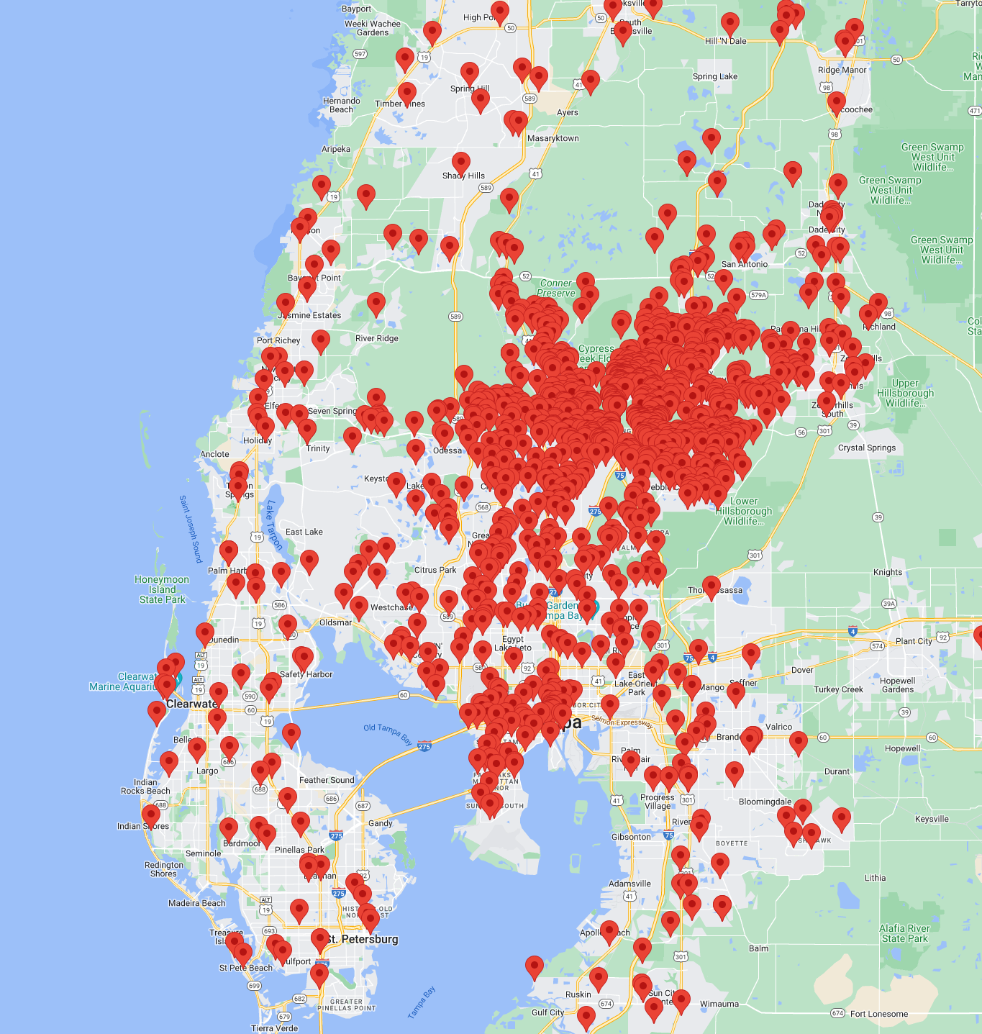
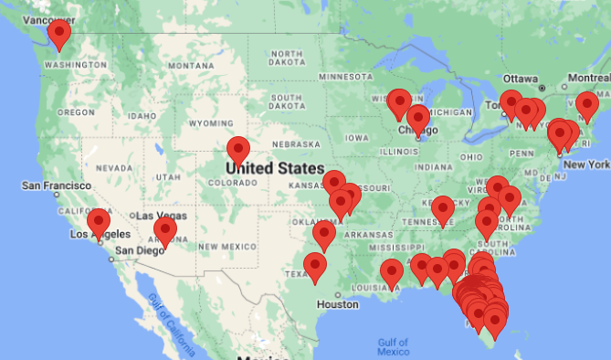
1,600+
… and counting
MSP | Email | VoIP | Network | Wi-Fi | Access Control | Camera | Alarm
Interested? (813) 444–4355

Slide 6
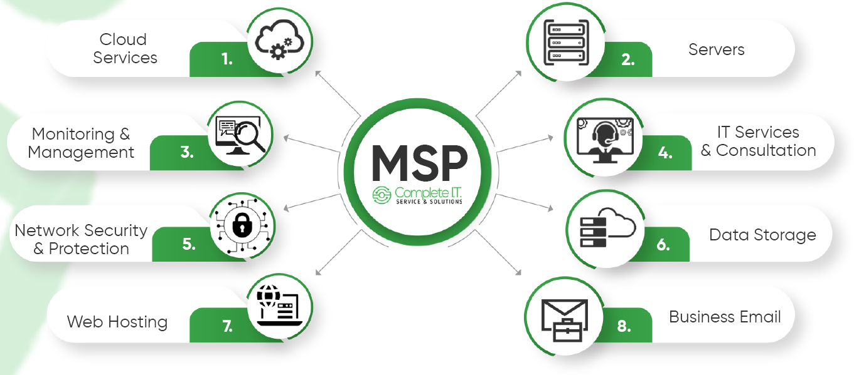
MSP Service
MSP | Email | VoIP | Network | Wi-Fi | Access Control | Camera | Alarm
Interested? (813) 444–4355

Slide 7

Email System
Stop
Yahoo, MSN, Hotmail, & AOL are not examples of a business email system
MSP | Email | VoIP | Network | Wi-Fi | Access Control | Camera | Alarm
Interested? (813) 444–4355

Slide 8
Email Security
POP3 & IMAP
Email no longer simply travels from your email server to your computer or smartphone
MSP | Email | VoIP | Network | Wi-Fi | Access Control | Camera | Alarm
Interested? (813) 444–4355

Slide 9

Email Security – Sender Validation
Email travels through security protocols such as SPF, DKIM, & DMARC
MSP | Email | VoIP | Network | Wi-Fi | Access Control | Camera | Alarm
Interested? (813) 444–4355

Slide 10
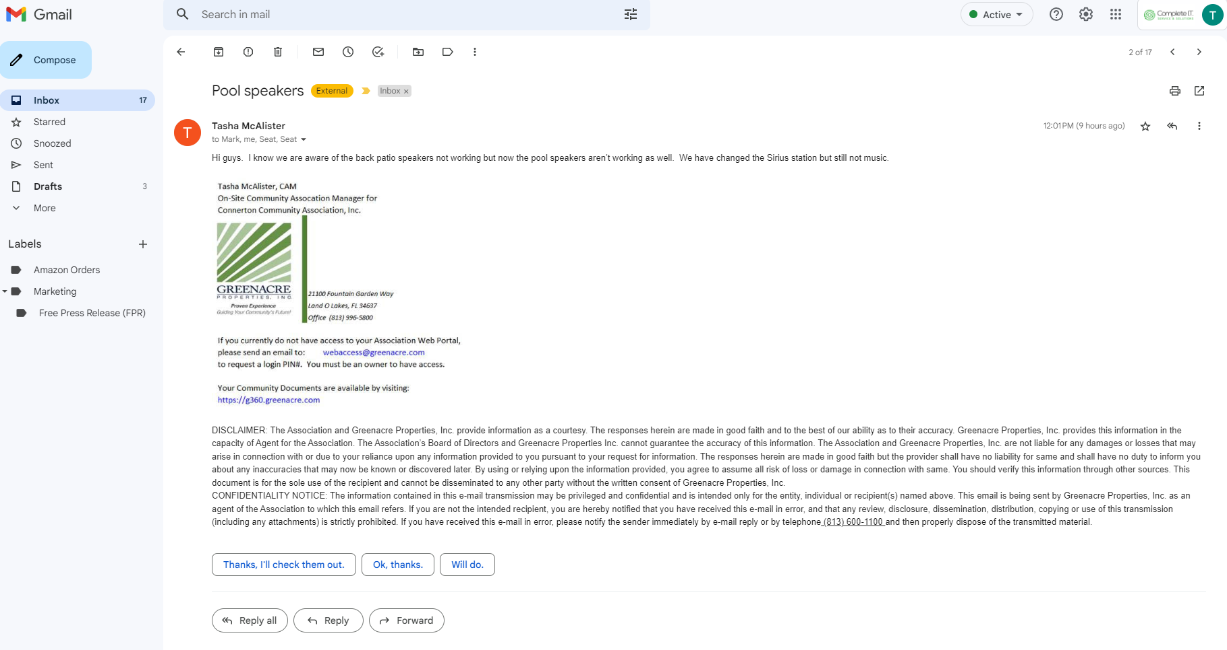
MSP | Email | VoIP | Network | Wi-Fi | Access Control | Camera | Alarm
Interested? (813) 444–4355

Slide 11
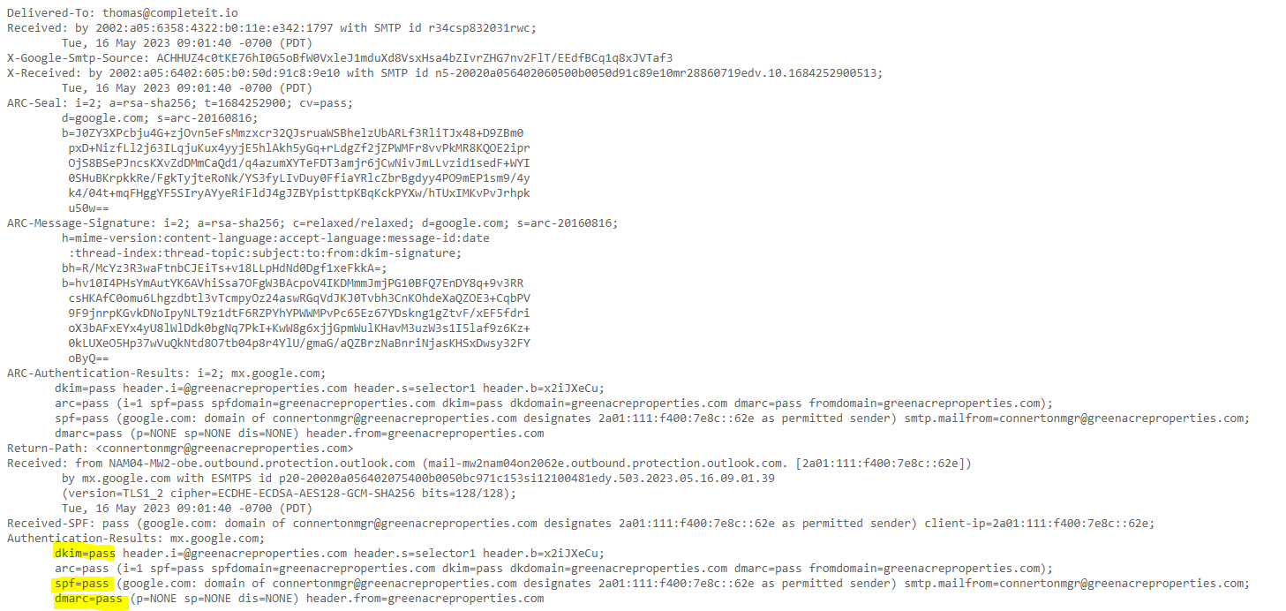
MSP | Email | VoIP | Network | Wi-Fi | Access Control | Camera | Alarm
Interested? (813) 444–4355

Slide 12
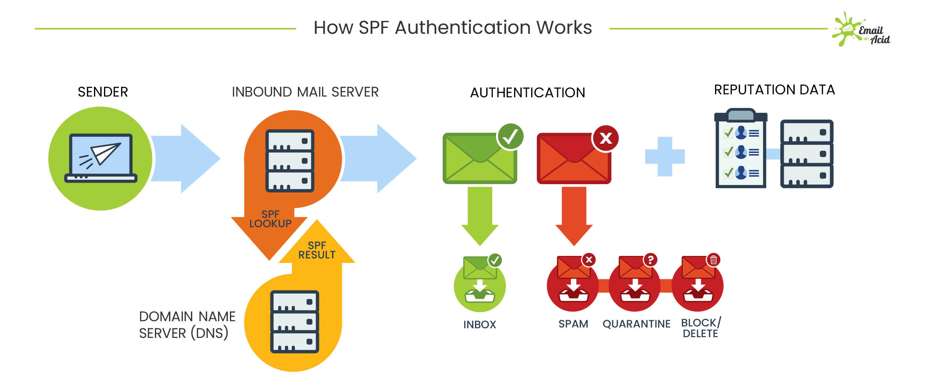
Simple Logic: IP True/False Statement
MSP | Email | VoIP | Network | Wi-Fi | Access Control | Camera | Alarm
Interested? (813) 444–4355

Slide 13
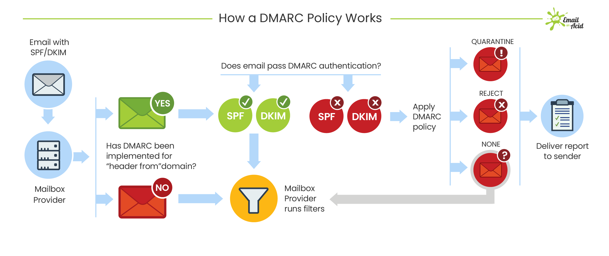
Creates a policy for handling spoofing events on DNS level
Requires SPF & DKIM
MSP | Email | VoIP | Network | Wi-Fi | Access Control | Camera | Alarm
Interested? (813) 444–4355

Slide 14

Email Security - Authentication
2FA = Two Factor Authentication
MSP | Email | VoIP | Network | Wi-Fi | Access Control | Camera | Alarm
Interested? (813) 444–4355

Slide 15
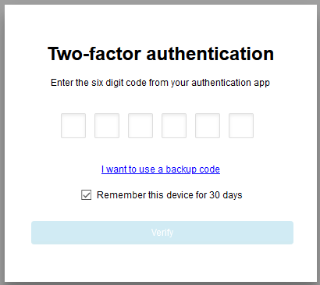
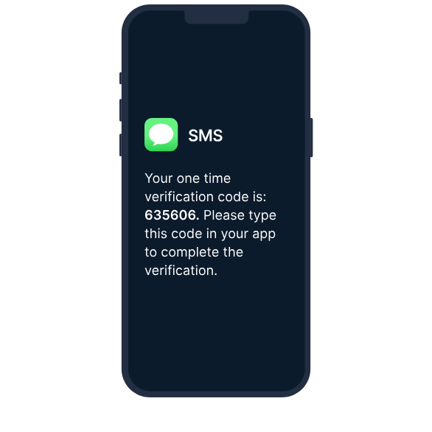
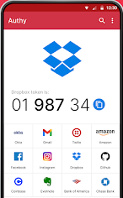
Email Security - Authentication
Email 2FA
Text 2FA
APP 2FA
MSP | Email | VoIP | Network | Wi-Fi | Access Control | Camera | Alarm
Interested? (813) 444–4355

Slide 16

Email Security - Filtering
Advanced threat protection = Enhanced spam filter
MSP | Email | VoIP | Network | Wi-Fi | Access Control | Camera | Alarm
Interested? (813) 444–4355

Slide 17
Computer Anti-Virus
MSP | Email | VoIP | Network | Wi-Fi | Access Control | Camera | Alarm
Interested? (813) 444–4355

Slide 18



Free Anti-Virus
Uninstall these Anti-Virus programs ASAP
MSP | Email | VoIP | Network | Wi-Fi | Access Control | Camera | Alarm
Interested? (813) 444–4355

Slide 19
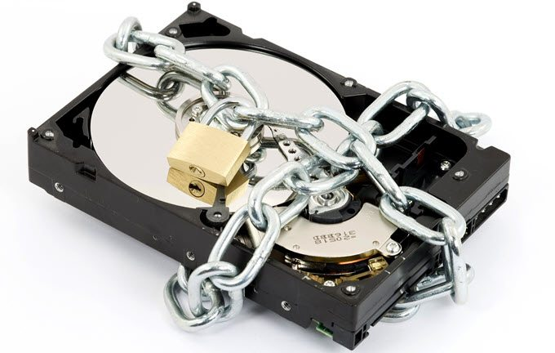
Computer Hard Drive
MSP | Email | VoIP | Network | Wi-Fi | Access Control | Camera | Alarm
Interested? (813) 444–4355

Slide 20

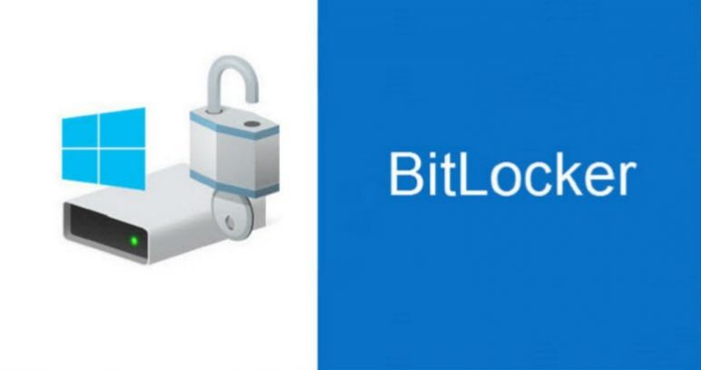
Computer Hard Drive - Encryption
Microsoft Windows Pro. Software version. Requires TPM Chip.
MSP | Email | VoIP | Network | Wi-Fi | Access Control | Camera | Alarm
Interested? (813) 444–4355

Slide 21
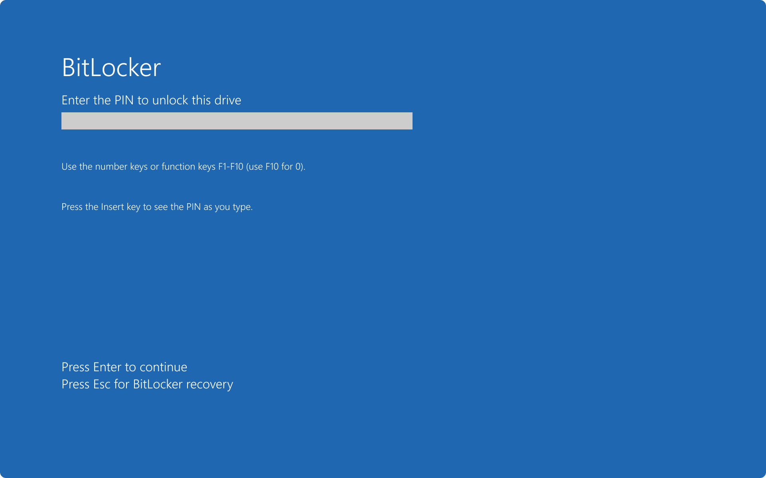
Computer Hard Drive - Encryption
If hard drive is removed, encryption key is required
MSP | Email | VoIP | Network | Wi-Fi | Access Control | Camera | Alarm
Interested? (813) 444–4355

Slide 22
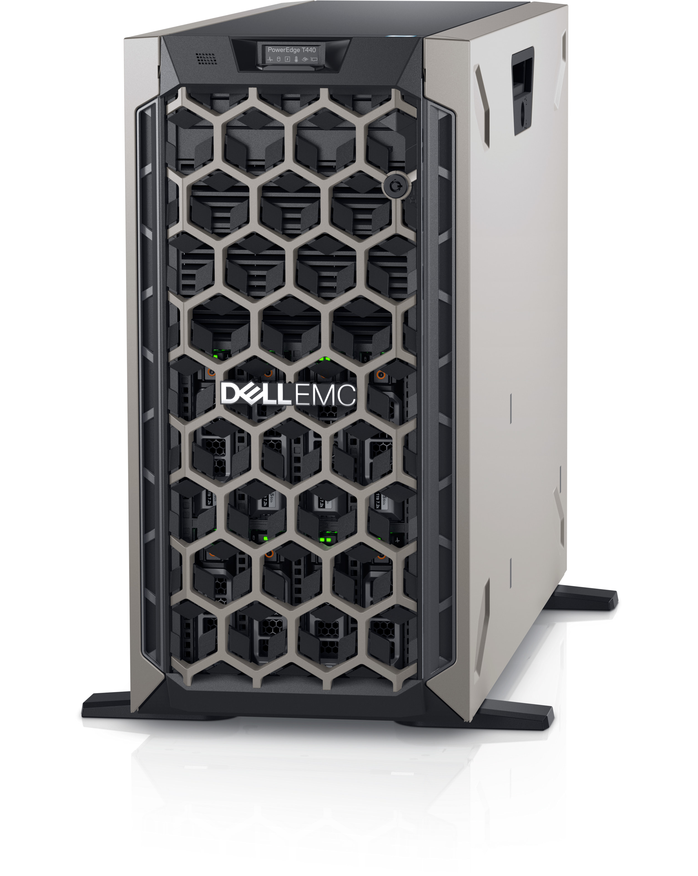
Servers
Large, loud, expensive. Required for domain & specialized software.
MSP | Email | VoIP | Network | Wi-Fi | Access Control | Camera | Alarm
Interested? (813) 444–4355

Slide 23

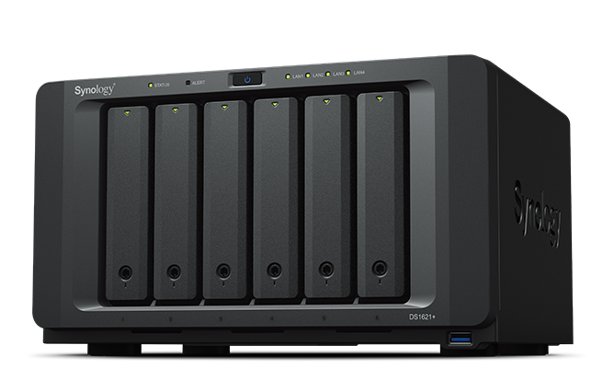
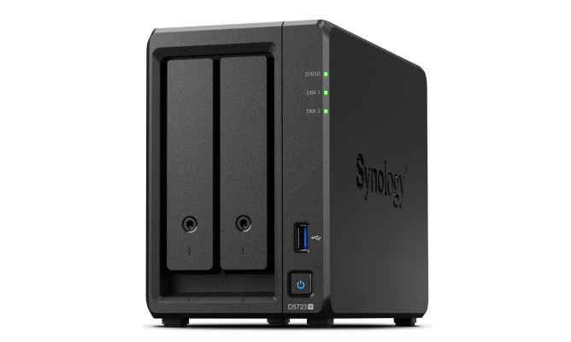
NAS Servers – File Server
Small form factor
Redundancy
MSP | Email | VoIP | Network | Wi-Fi | Access Control | Camera | Alarm
Interested? (813) 444–4355

Slide 24
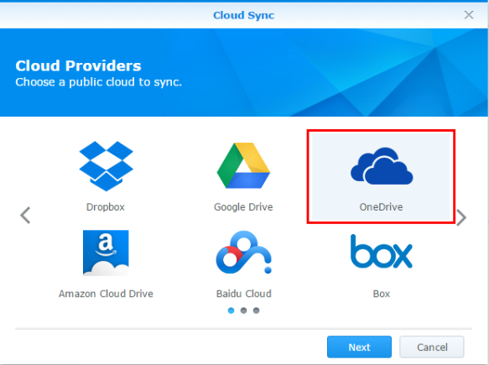

NAS Servers – Data Backup
MSP | Email | VoIP | Network | Wi-Fi | Access Control | Camera | Alarm
Interested? (813) 444–4355

Slide 25
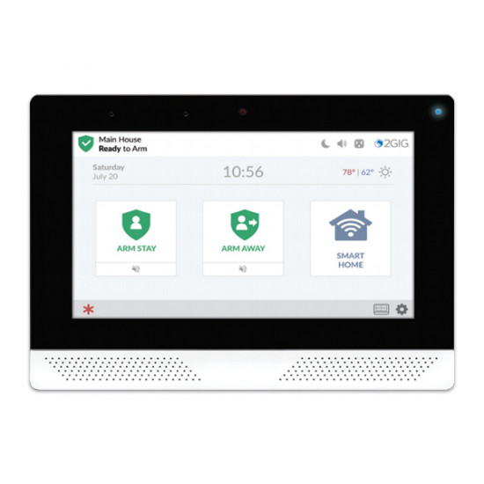
Physical Security - Intruder Alarm System
Alarm monitoring certificate for insurance
MSP | Email | VoIP | Network | Wi-Fi | Access Control | Camera | Alarm
Interested? (813) 444–4355

Slide 26
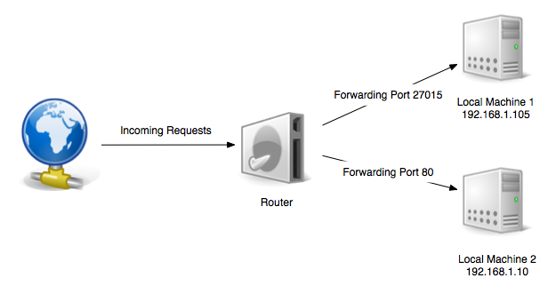
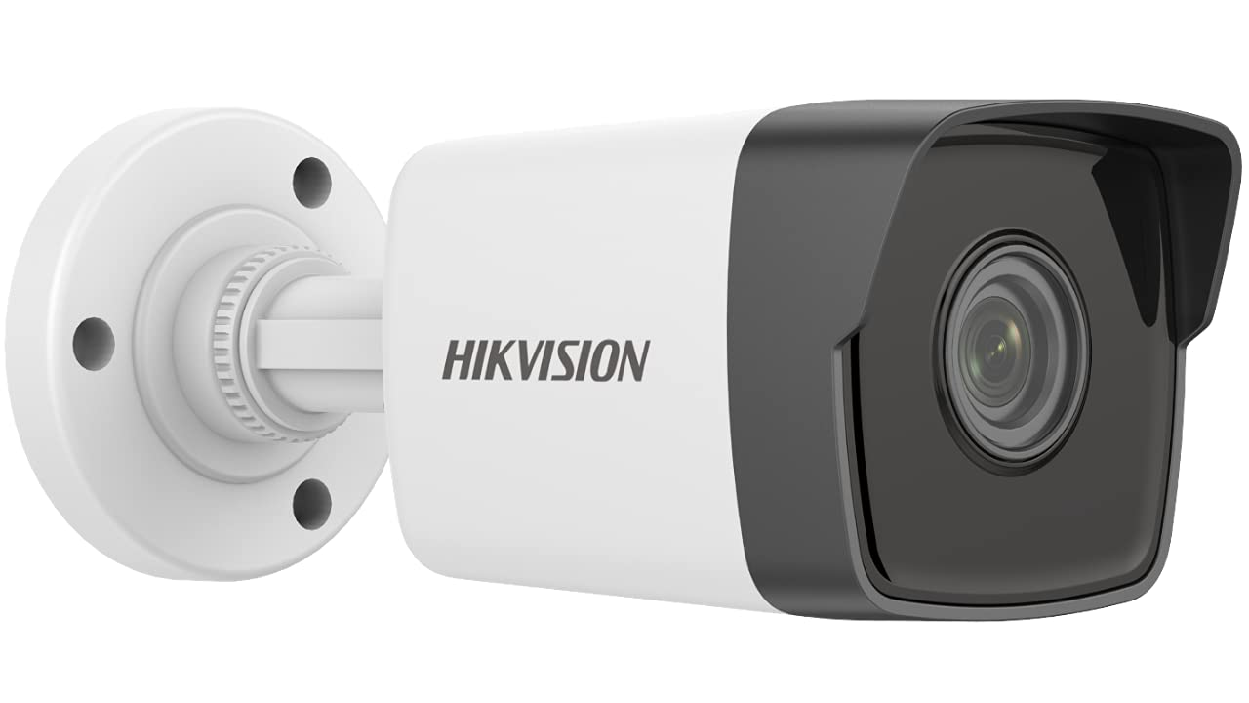
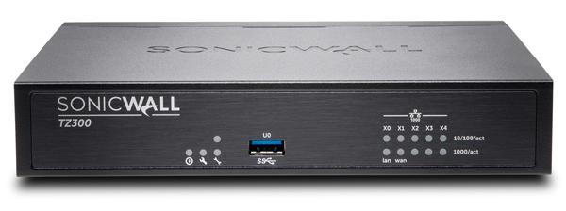
Port Forwarding
Quick and easy setup. Will haunt you later.
MSP | Email | VoIP | Network | Wi-Fi | Access Control | Camera | Alarm
Interested? (813) 444–4355

Slide 27

NDAA Compliance
Ensuring data is encrypted, implementing multi-factor authentication, and conducting regular risk assessments.
(Federal Funded Projects)
MSP | Email | VoIP | Network | Wi-Fi | Access Control | Camera | Alarm
Interested? (813) 444–4355

Slide 28
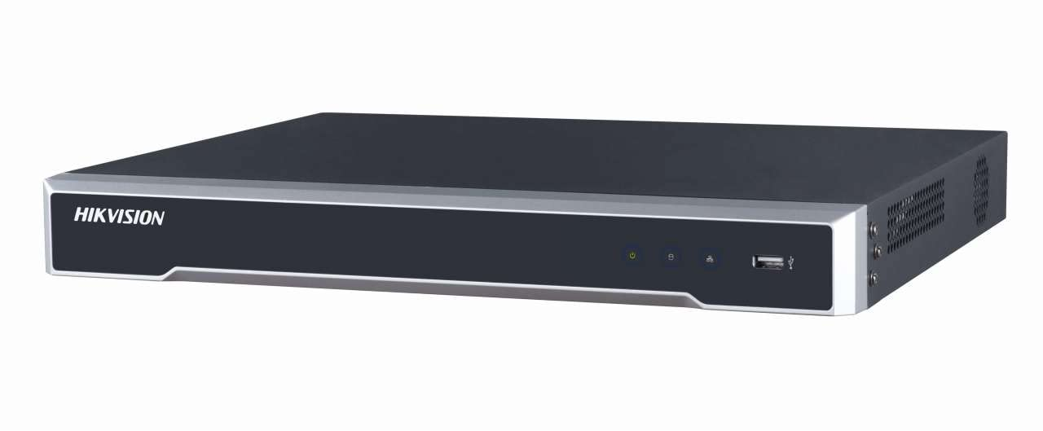

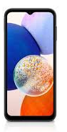

DDNS Overseas
MSP | Email | VoIP | Network | Wi-Fi | Access Control | Camera | Alarm
Interested? (813) 444–4355

Slide 29

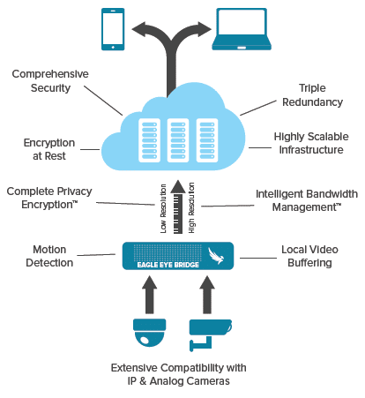
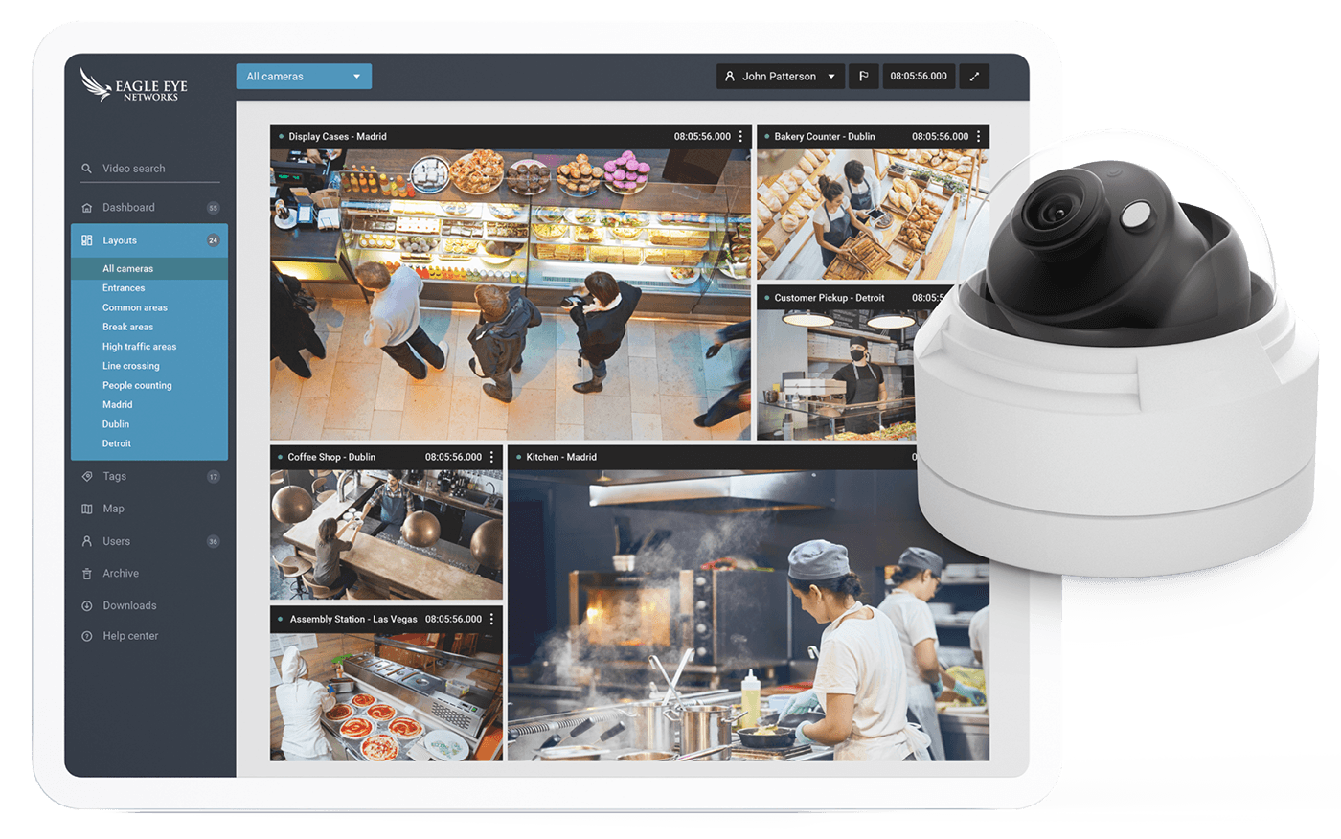
Encrypted Camera System
MSP | Email | VoIP | Network | Wi-Fi | Access Control | Camera | Alarm
Interested? (813) 444–4355

Slide 30


Physical Lock & Key
MSP | Email | VoIP | Network | Wi-Fi | Access Control | Camera | Alarm
Interested? (813) 444–4355

Slide 31
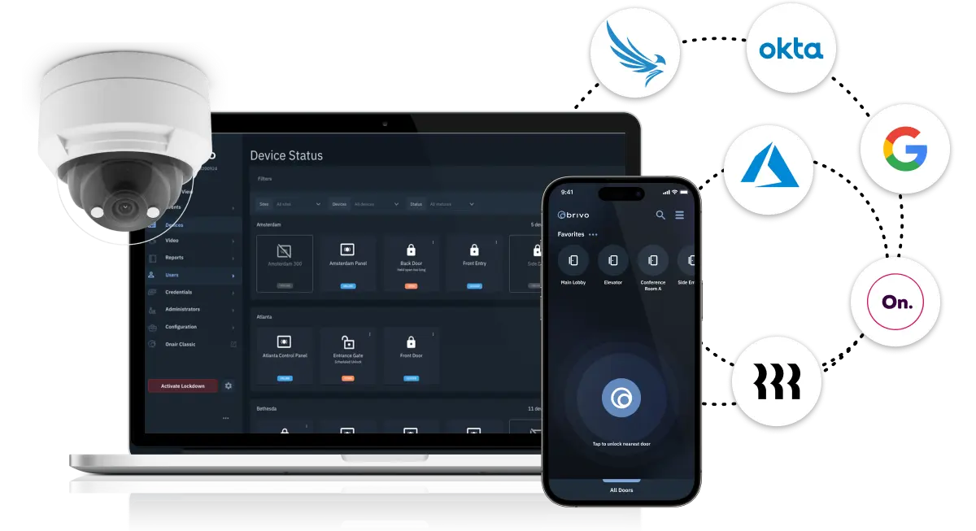
Door Access Control
MSP | Email | VoIP | Network | Wi-Fi | Access Control | Camera | Alarm
Interested? (813) 444–4355

Slide 32
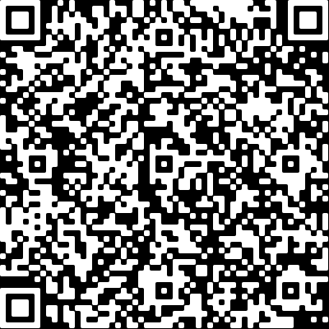
Questions For Thomas?
MSP | Email | VoIP | Network | Wi-Fi | Access Control | Camera | Alarm
Interested? (813) 444–4355

